Slide 1

PROGRAM
CATALOG
2023

Slide 2
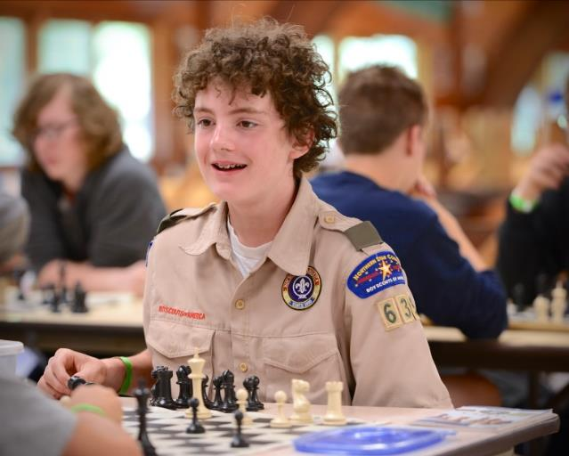
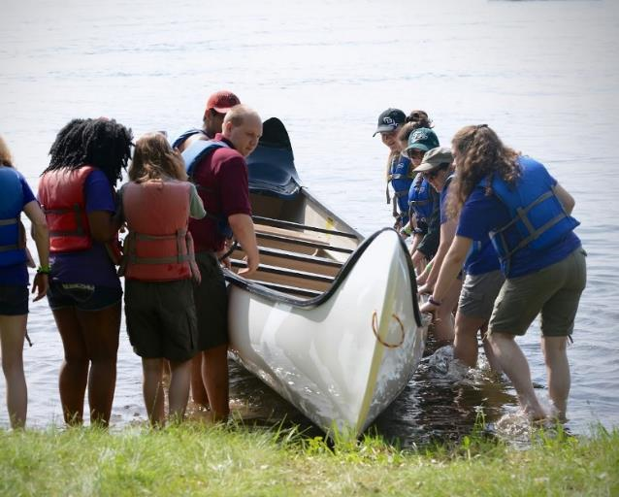
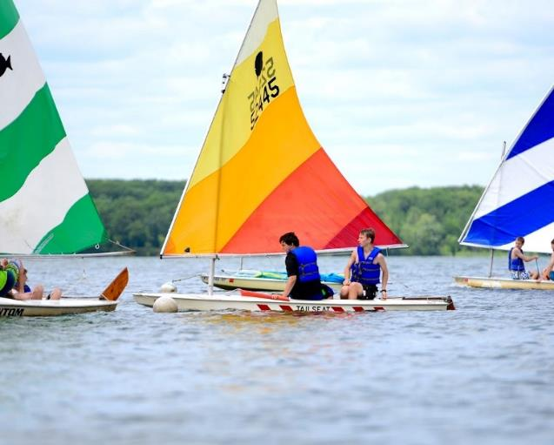
SCHEDULE OVERVIEW
Morning (Advancement Time)
In the morning, Scouts work on merit badges in classes scheduled in the form of “Blocks”. There are four blocks in the morning.
Afternoon (troop Time)
In the afternoon, the Troop participates in activities as a group. Preferences are submitted in advance. Staff develop a schedule for you.
Evening (open Time)
After supper Scouts explore camp with their buddy or patrol. Swim at the beach, climb the tower, or go to the shooting ranges!
High Adventures and Specialty Programs for Older Scouts
High Adventure programs are commonly all-day long, but some are only half-day. Please review schedules carefully to ensure you don’t overbook yourself. There are ways to organize your schedule to incorporate some high adventures, all-day programs, and all-morning programs alongside some merit badges.
The following schedule will give you a rough idea of what the Tomahawk program looks like and how it is organized. Some programs may take up multiple time slots, a full morning or a full day!

Slide 3
SCHEDULE OVERVIEW
 | SUN | MON | TUE | WED | THURS | FRI | SAT
7:30 AM- 8:30 AM |  | Breakfast
8:45 AM-10:25 AM |  | Merit Badge Session 1 MWF | Merit Badge Session 1 T,TH | Merit Badge Session 1 MWF | Merit Badge Session 1 T,TH | Merit Badge Session 1 MWF | Check- Out
10:35 AM-12:15 PM |  | Merit Badge Session 2 MWF | Merit Badge Session 2 T,TH | Merit Badge Session 2 MWF | Merit Badge Session 2 T,TH | Merit Badge Session 2 MWF
12:30 PM |  | Lunch
2:00 PM | Check-In, Set up, Dining Orientation Swim Tests | Troop/ Crew Activity | Troop/ Crew Activity | Troop/ Crew Activity | Troop/ Crew Activity | Troop/ Crew Activity
3:00 PM |  | Troop/ Crew Activity | Troop/ Crew Activity | Troop/ Crew Activity | Troop/ Crew Activity | Troop/ Crew Activity
4:00 PM |  | Troop/ Crew Activity | Troop/ Crew Activity | Troop/ Crew Activity | Troop/ Crew Activity | Troop/ Crew Activity
6:00 PM | Supper
7:00 PM - 8:30 PM | Roundtable Camp Tour Campfire | Open Program | Open Program | Open Program | Open Program | Closing Campfire

Slide 4

FEES/FINANCIAL
PARTICIPANT FEES
Youth Fee: $350
Adult Full Week: $130
Adult Partial Week:
Sunday $15
Monday-Friday $25/day
Saturday $10
Bringing your own food?
Troops/Scouts bringing their own food pay $45 less per person.
PROGRAM FEES
Some programs have an additional charge for supplies provided or specialty staff/equipment. Review the Program Catalog for details.
FINANCIAL ASSISTANCE
For Scouts who are not able to afford the full fee of camp, there is financial support available. This assistance is like a scholarship for camp. We call these camperships. The funds to provide camperships are supplied by donors in Northern Star Council and are ear-marked for Northern Star Scouts only.
To apply, go online or scan the QR Code below. Applications due by June 1st

Slide 5


Merit Badge Information
Merit Badge Rotation
Each summer we swap in some merit badges and swap out others. We do this to provide more merit badge options to Scouts over all the years they camp at Tomahawk.
Merit Badges Offered Even Years:
Bird Study, Forestry, Mammal Study, Orienteering, Rowing, Salesmanship, Soil & Water Conservation, Weather
Merit Badges Offered Odd Years:
Fingerprinting, Geocaching, Geology, Insect Study, Nature, Oceanography, Pioneering, Plant Science
When program registration opens
For Merit Badges and High Adventures programs (individual programs) sign up opens on different dates in April to give the oldest Scouts the first opportunity to book programs. Registration is first come, first served.
Here is the Individual Program
registration schedule :
April 4th at 7pm: 16 and older
April 11th at 7pm: 14 and older
April 18th at 7pm: 10 and older
Registration will be closed on the days above from 3pm to 6:59pm to make minimum age adjustments.
Troop Activities:
Your camp coordinator will collect your troop activity rankings and submit rankings on behalf of the troop starting April 4th. These are due by June 1st.
Merit Badge Prep
Learning doesn’t start at camp. Before you come to camp, review the Merit Badge Pamphlet for each badge you are taking. These pamphlets are extremely helpful and are available for sale in your local Scout Shop.
A Balanced Schedule
At Tomahawk, we offer a schedule that balances advancement with fun activities. Scouts should earn merit badges, but that shouldn’t be all they do at camp. At Tomahawk, mornings are generally spent on merit badges, afternoons are spent doing fun activities as a troop, and evenings are for the patrol or buddy groups to explore open areas of camp together.

Slide 6
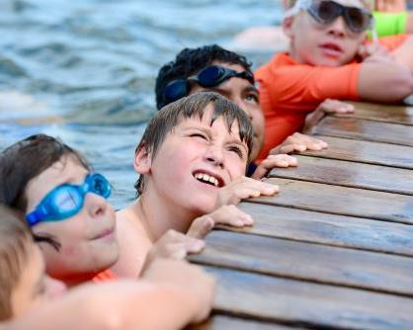
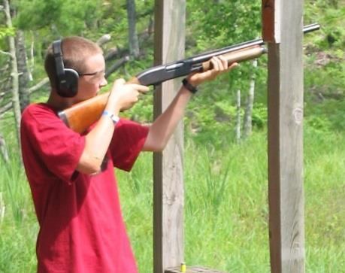
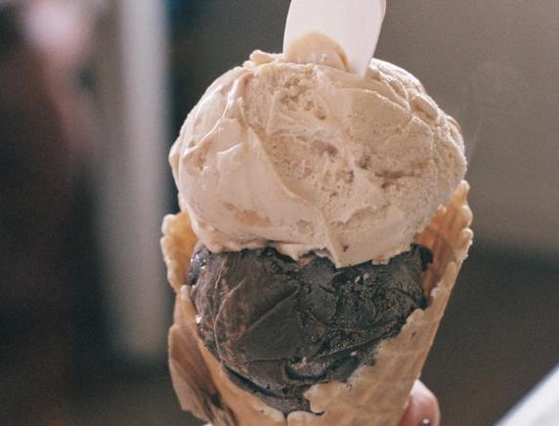
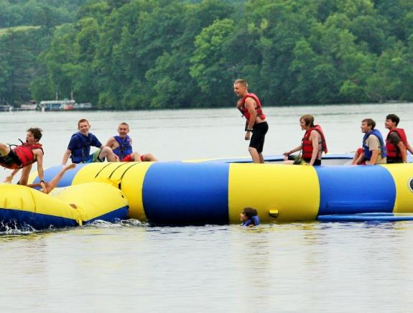
TROOP ACTIVITIES
Rank Your Troop Activity Options
In the afternoon, the Troop participates in activities as a group. Review the following programs and pick your top ten that you’d like to do with your troop. Communicate your top ten troop activities with your camp coordinator using the Scout Program Planning Worksheet.
Your camp coordinator will take the top choices from everyone in your troop and submit your troop’s
collective top 15 choices to camp. The camp staff will use your troop’s submission to craft an afternoon scheduled tailored to your troop.
Troop Swim
Troop Snorkeling
Shotgun Shooting
ICE CREAM OUTPOST
Aqua trampoline

Slide 7
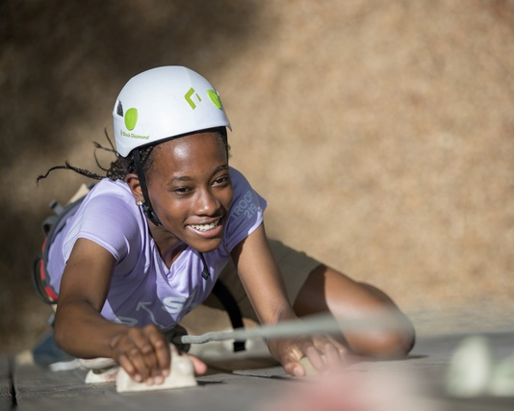
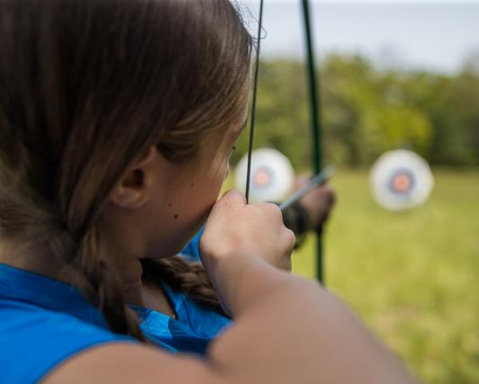
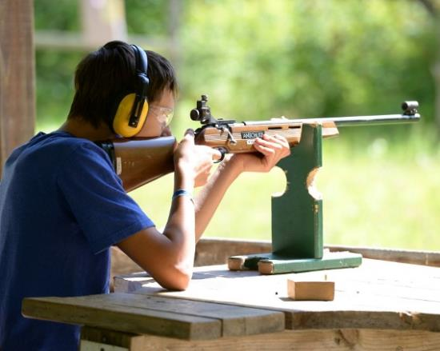
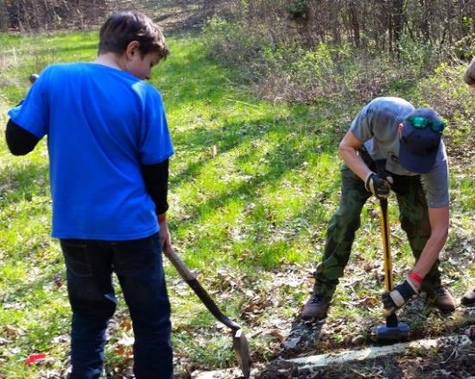
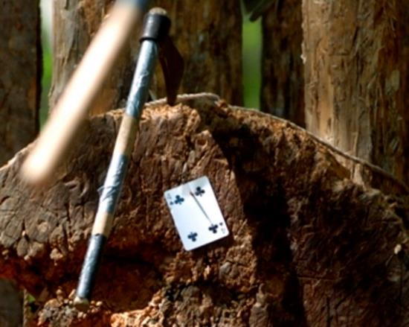
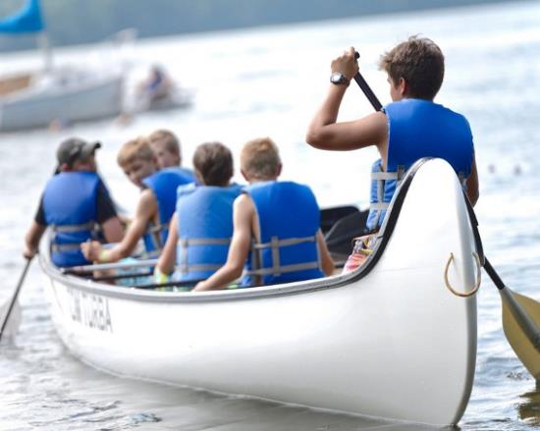
TROOP ACTIVITIES
Troop climb
Archery shooting
Rifle shooting
Conservation project
Tomahawk throwing
Voyageur canoe

Slide 8

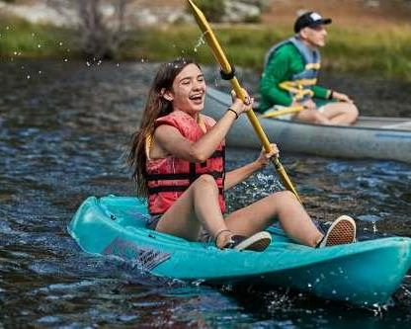
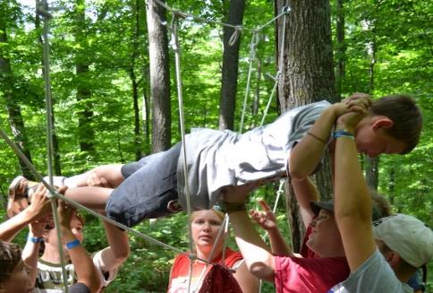
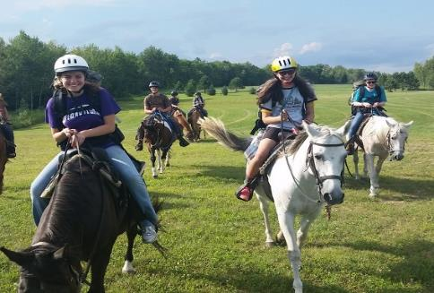
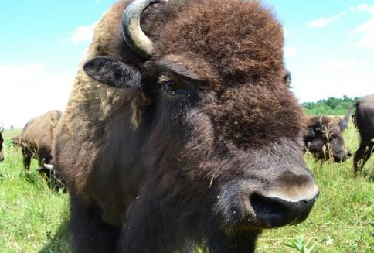
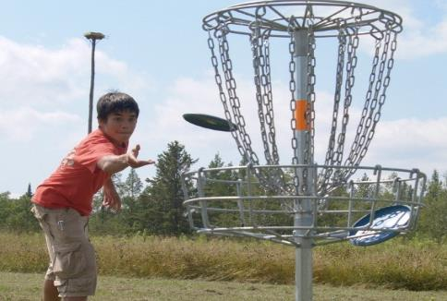
TROOP ACTIVITIES
TIE DYE T-SHIRT MAKING
Troop Boating
Team building games
Have everyone in your troop tie dye a shirt, handkerchief or other item. White shirts with Tomahawk logos are available in the trading post.
Choose from canoes, kayaks, row boats or paddle boards for this troop activity. Go to the other side of the lake, fish or play boat tag.
Want to grow stronger as a patrol and troop? Play games that challenge your communication, team work, and cooperation skills.
Horseback ride
Bison, Fire Tower,
History & Bike Tour
Disc golf
Scheduled for two hours. Rides will be an hour long, but travel/prep time is needed on either end of ride. Rides are $20 per person.
Grab a bike from the Berglund Center and find the Bison by bike. Ride down to the Fire Tower and return for a tour on the history exhibit.
Play the 18 hole Tomahawk disc golf course. Or play 9 holes before or after a bike tour.

Slide 9
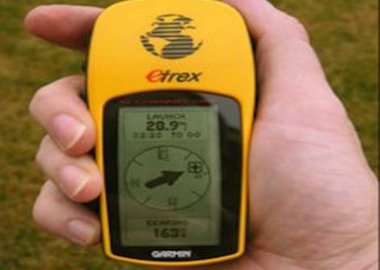
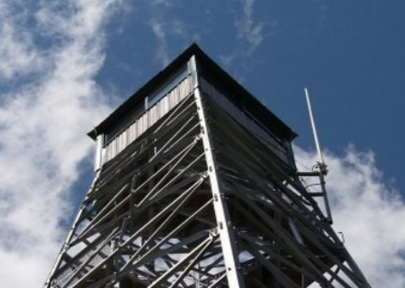

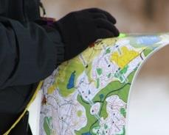
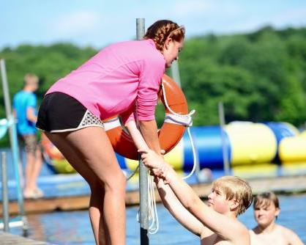
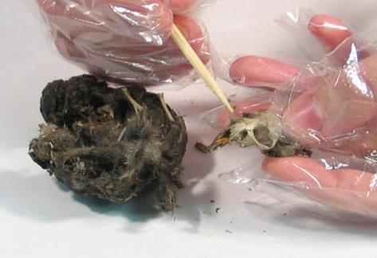
TROOP ACTIVITIES
Turks head slide
Geocaching
Fire Tower
Monkey fist knot
Explore camp by GPS. Take an item from a geocache and leave an item for others to find. We provide the GPS units and instruction.
Climb 100’ in the air and see above the trees. See the Mega Tower and Long Lake. Discuss how fire towers worked to spot fires.
Create something truly unique in Handicraft. Make a Turks Head to use as a neckerchief slide or a
monkey fist key chain.
Orienteering course
First class aquatics
OWL PELLETS
Go through the 1 mile orienteering course. Use map and compass to find all the controls in the woods. Will your troop be the fastest?
Need to do reaching, throwing, and line and tender rescues? We’ve got you covered. This can be paired with a troop swim.
Dissect owl pellets in Ecology and learn about the many things that make owls unique.

Slide 10
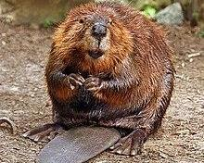
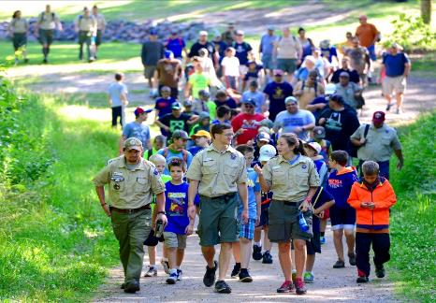
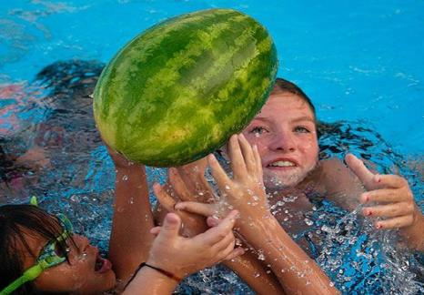
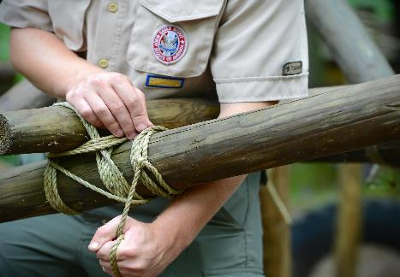
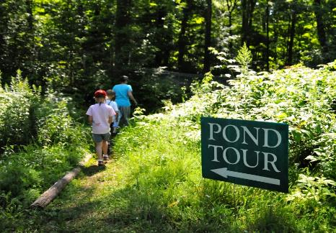
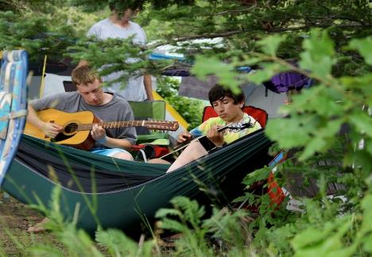
TROOP ACTIVITIES
BEAVER TAILS
5 MILE HIKE
WATERMELON MAUL
Beavers are considered a keystone species. Learn how beavers shape their environment for themselves and other plants and animals.
A 5 mile hike is a requirement for advancement. Tomahawk is a perfect place to do this. This activity pairs well with a trip to Logging Camp.
This fast paced game at the beach will build up an appetite. Afterwards, enjoy some tenderized watermelon.
LEAVE NO TRACE
PIONEER POWER
NATURE /BOG HIKE
Campsite/Free Time
Learn and practice your lashing while building a useful camp gadget in Scoutcraft.
Learn about leave no trace or go on nature walk. Bog walk not available in White Pine.
Sometimes your campsite is the best place to be. If you’d like extra time to do your own thing or rest let us know.

Slide 11
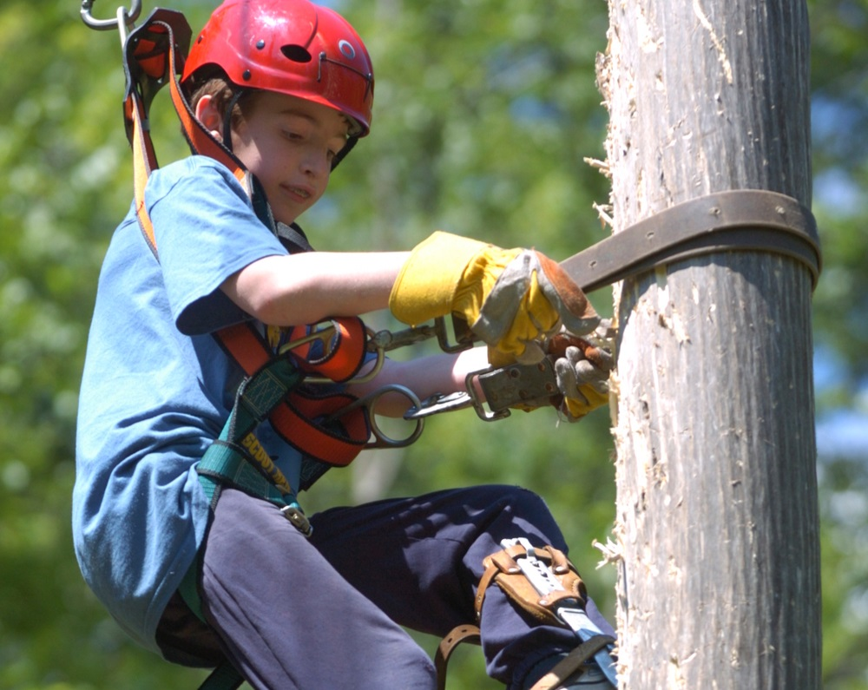
TROOP ACTIVITIES
Logging Camp
TRAVEL BACK TO 1893
From chopping wood to making candles, the Knapp Stout Logging Camp on Long Lake will teach you how to be a bona-fide lumberjack!
Take a swing at the forge and make a mini-tomahawk, or use the two-person saws to cut a wood cookie that you can brand with the blacksmiths.
Personalize a mug, water bottle, or wood cookie by branding it with one of our many branding irons.
Explore the log cabin, originally constructed before the Civil War.
There are three ways to experience logging camp:

Slide 12
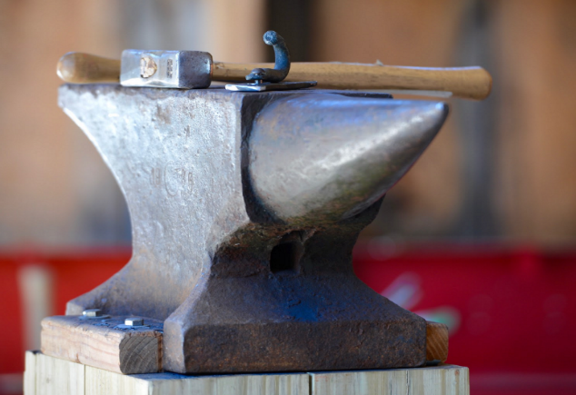
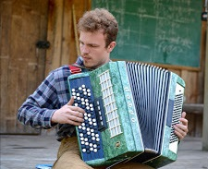
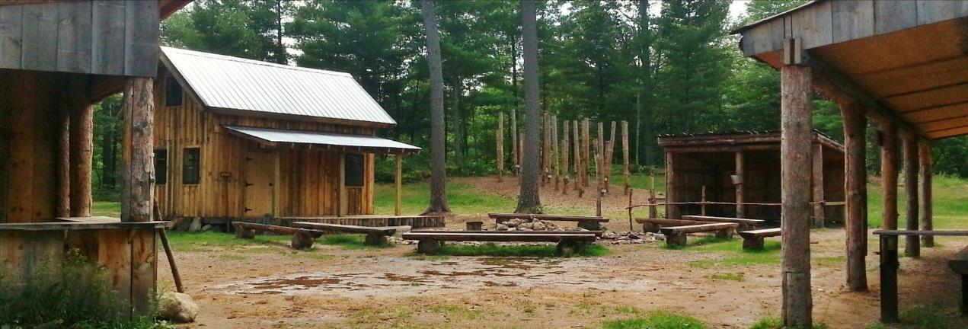
LOGGING CAMP
Afternoon Session
Hike or drive up to Logging Camp right after lunch and experience programs from 2:00pm to 4:00pm. Hike or drive back to camp in time for supper.
Supper Session
Hike or drive up to Logging Camp later in the afternoon and experience programs from 4:30pm to 5:30pm. Cook supper with logging camp staff and do one last program from 6:30pm to 7:30pm before returning back to your camp.
Logging Overnight
This option is only available for Scouts 14 and older on select nights. See details on the Logging Overnight program description on page 14.

Slide 13
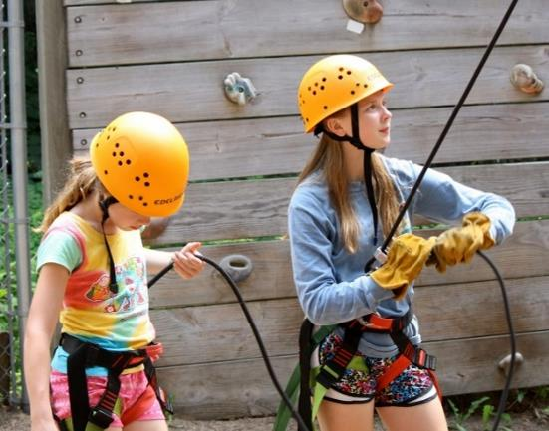
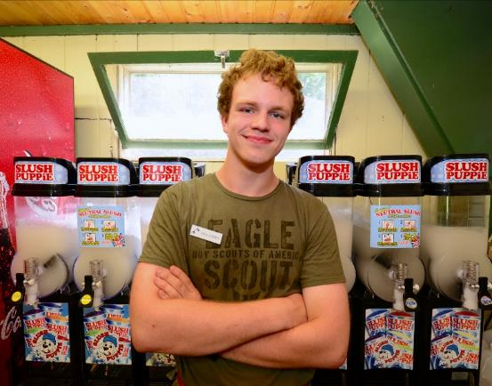
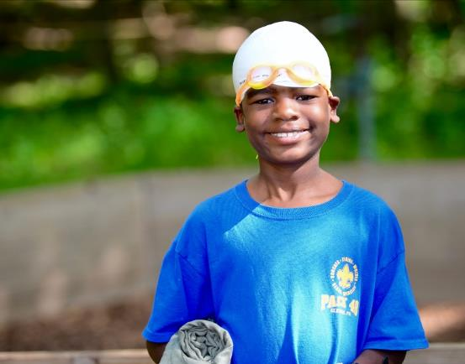
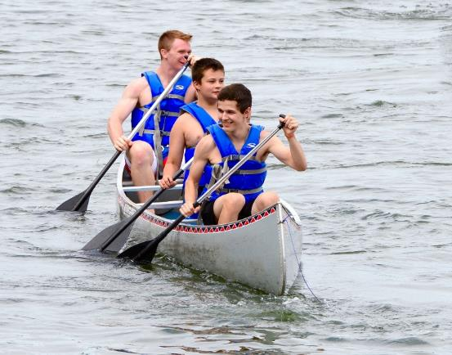
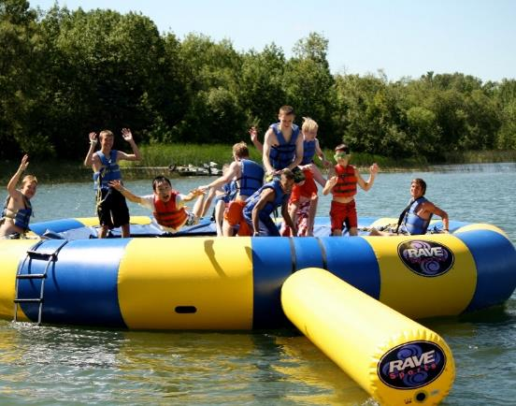
EVENING ACTIVITIES
The evening is yours!
From 7:00pm to 8:30pm you are free to explore camp with a buddy or your patrol. All the areas of camp are open. Take a shower, climb the tower, go swimming, or compete in some awesome challenges. Take a look at all the options that await you before sunset! This is a great time to find staff help with merit badge make up work.
OPEN TOWER
OPEN TRADING POST
OPEN SWIM
OPEN BOATING
OPEN AQUATRAMPOLINE

Slide 14
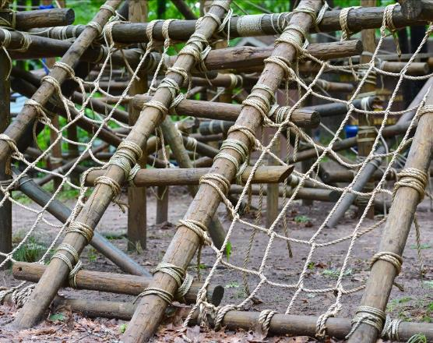
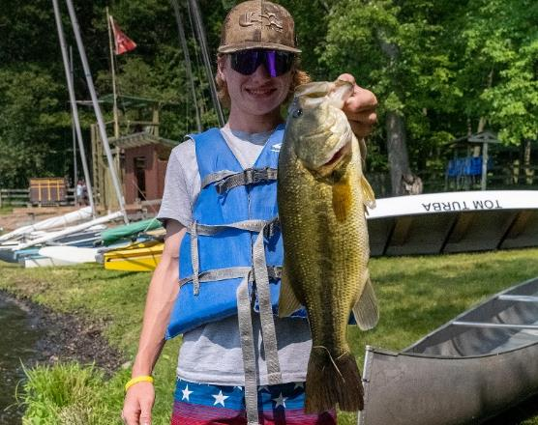
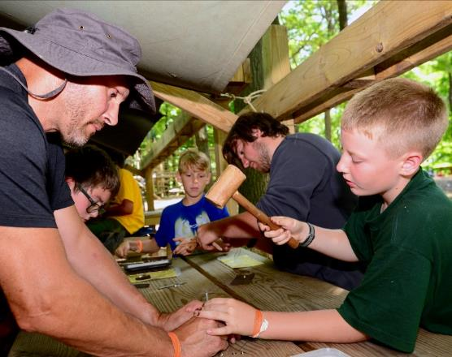
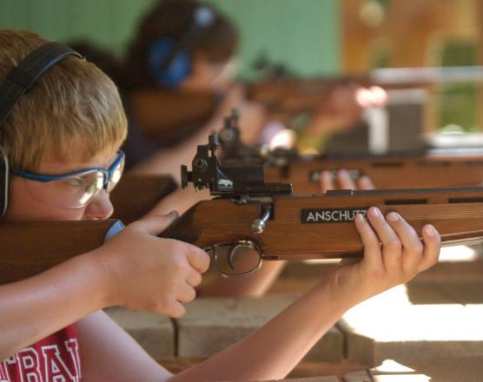
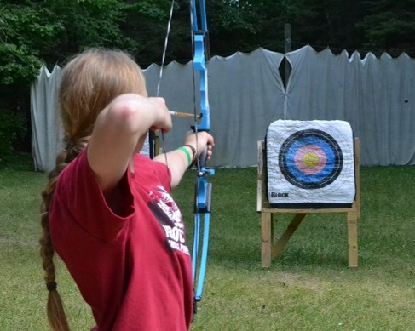
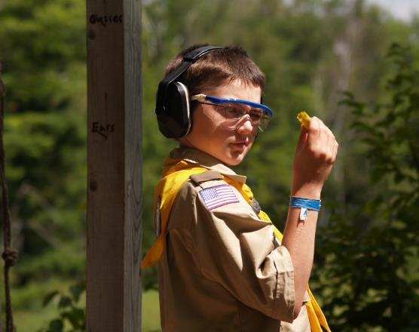
EVENING ACTIVITIES
OPEN SCOUTCRAFT
OPEN FISHING
OPEN HANDICRAFT
OPEN RIFLE
OPEN ARCHERY
OPEN SHOTGUN

Slide 15
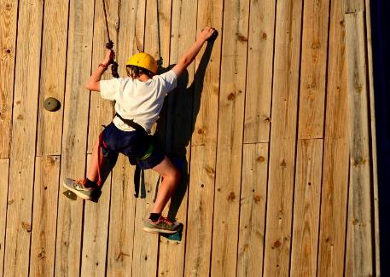
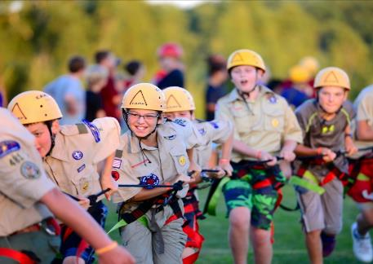
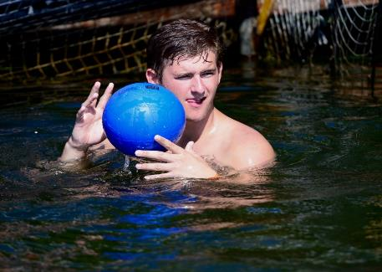
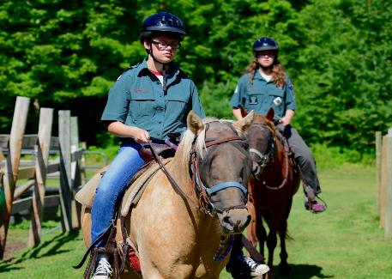
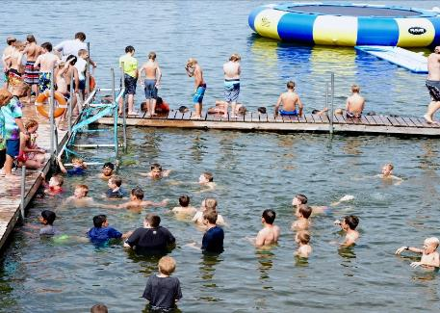

EVENING ACTIVITIES
TOURNAMENTS: WATERPOLO
VOLLEYBALL & CHESS
HIGH ADVENTURE
FUN NIGHT
TOWER RACES
Who’s the fastest climber in camp? Only one way to find out—multi bracket competition. Race against all of the fastest Scouts in camp.
Offered on Monday night to Scouts aged 10-12 to learn about the many High Adventure opportunities awaiting them in summers to come.
Troops and patrols compete against each other through the week. The winners get to play against the staff at the end of the week.
HORSEBACK RIDING
BEACH BASH
POKER SHOOT
The horse corral is open every night. Go on a trail ride or just hang out with the horses. Sign up for horse rides with your commissioner.
Wednesday night is Beach Bash! Swim, play games, win points, sink a rowboat, listen to music, and enjoy cheeseburgers in paradise.
How’s your aim? Can you shoot the best hand of cards? Shoot stuff, with stuff, at stuff with your friends at this fast paced shootout.

Slide 16
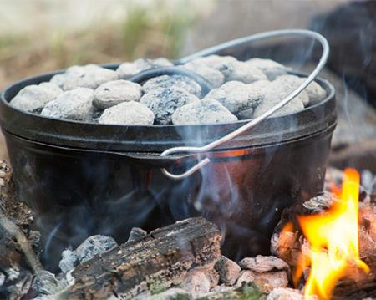


EVENING ACTIVITIES
COOKING DEMO
ROPE MAKING DEMO
5K ROOT BEER RUN
MILE SWIM
Learn how to cook in a Dutch oven on Tuesday night in Scoutcraft. Learn how rope is made on Monday night in Scoutcraft. Help make rope.
Run or walk the 5K from Chippewa, to Navajo, to Sioux, and back to Chippewa. Winners sign the banner. Everyone gets a root beer float.
Build up to swimming a mile throughout the week to earn the Mile Swim patch to put on your swimsuit.

Slide 17

BROWNSEA
What is Brownsea?
Brownsea is designed to teach basic outdoor skills to 1st year Scouts. Many requirements won’t be signed off during class but will need to be demonstrated to adults or troop guides in the campsite. Commissioners can also assist with testing Scouts out on skills in the evening.
First Aid and Flag Day
Tenderfoot 7a. Demonstrate how to display, raise, lower, and fold the U.S. flag.
First Class 7a. Demonstrate bandages for a sprained ankle and for injuries on the head, the upper arm, and the collarbone.
First Class 7b. By yourself and with a partner, show how to:
Transport a person from a smoke-filled room
Transport for at least 25 yards a person with a sprained ankle.
Sharp and pointy Day
Tenderfoot 3d. Demonstrate proper care, sharpening, and use of the knife, saw, and ax. Describe when each should be used.
2nd Class 2b. Use the tools listed in Tenderfoot requirement 3d to prepare tinder, kindling, and fuel wood for a cooking fire.
Fire and Stove Day
2nd Class 2a. Explain when it is appropriate to use a fire for cooking or other purposes and when it would not be appropriate to do so.
2nd Class 2c. At an approved outdoor location and time, use the tinder, kindling, and fuel wood from Second Class requirement 2b to demonstrate how to build a fire. Light the fire. After allowing the flames to burn safely for at least two minutes, safely extinguish the flames with minimal impact to the fire site.
2nd Class 2d. Explain when it is appropriate to use a lightweight stove and when it is appropriate to use a propane stove. Set up a lightweight stove or propane stove. Unless prohibited by local fire restrictions, light the stove. Describe the safety procedures for using these types of stoves.
Schedule
Brownsea is offered during Session 1 and the program runs Monday-Friday. When you sign up, you’ll select Brownsea Group A, B, or C. Each group will have a different schedule.
Nature Day
Tenderfoot 4b. Describe common poisonous or hazardous plants, identify any that grow in your local area or campsite location. Tell how to treat for exposure to them.
2nd Class 1b. Explain the principles of Leave No Trace and tell how you practiced them on a campout or outing.
2nd Class 4. Identify or show evidence of at least ten kinds of wild animals (such as birds, mammals, reptiles, fish, mollusks) found in your local area or camping location. You may show evidence by tracks, signs, or photographs you have taken.
1st Class 1b. Explain each of the principles of Tread Lightly! and tell how you practiced them on a campout or outing.
1st Class 5a. Identify or show evidence of at least 10 kinds of native plants found in your local area or campsite location.
Orienteering Day
2nd Class 3a. Demonstrate how a compass works and how to orient a map. Use a map to point out and tell the meaning of five map symbols.
1st Class 4a. Using a map and compass, complete an orienteering course that covers at least one mile and requires measuring the height and/or width of designated items (tree, tower, canyon, ditch, etc.)
What’s taught
Refer to the columns to the right for details. Knot instruction will be spread out through the week.
Aquatics, Hiking, and Lashing
requirements can be accomplished during select troop activities in the afternoon.
 | A | B | C
Sharp&Pointy | MON | TUE | WED
Fire/Stove | TUE | WED | THUR
First Aid Flag | WED | THUR | FRI
Orienteering | THUR | FRI | MON
Nature | FRI | MON | TUE

Slide 18
SCHEDULE
Session 1 8:45-10:25 | Session 1 MWF Block | Session 1 TTh Block
 | Brownsea Monday-Friday
 | Lifesaving MB Monday-Friday
 | Archery MB | Chess MB
 | Basketry MB | Emergency Prep. MB
 | Camping MB Option 1 | Fishing MB Option 1
 | Climbing MB Option 1 | Kayaking MB Option 1
 | Complete Angler Bundle (Attend both session 1 &2) | Nature MB
 | Environmental Science MB Option 1 | Oceanography MB
 | Horsemanship MB (Attend session 1 &2) | Personal Fitness MB
 | Rifle Shooting MB Option 1 | Plant Science MB
 | Space Exploration MB | Shotgun Shooting MB (Attend session 1 &2)
 | Swimming MB Option 1 | STEM NOVA Shoot! (Attend session 1 &2)
 | STEM NOVA Whoosh! (Attend session 1 &2)
Session 2 10:35-12:15 | Session 2 MWF Block | Session 2 TTh Block
 | Camping MB Option 2 | Astronomy MB
 | Canoeing MB | Cooking MB
 | Climbing MB Option 2 | Fingerprinting MB
 | Environmental Science MB Option 2 | Fishing MB Option 2
 | First Aid MB | Geology MB
 | Pioneering MB | Insect Study MB
 | Geocaching MB | Kayaking MB Option 2
 | Horsemanship MB (Attend both session 1 &2) | Leatherwork MB
 | Rifle Shooting MB Option 2 | Photography MB
 | STEM NOVA Whoosh (Attend session 1 &2) | STEM NOVA Shoot! (Attend session 1 &2)
 | Swimming MB Option 2 | Shotgun Shooting MB (Attend session 1 &2)
 | Wilderness Survival. MB | Swimming Lessons
 | Woodcarving MB

Slide 19
SCHEDULE
Older Scout Program | Monday |  | Tuesday |  | Wednesday |  | Thursday |  | Friday
 | 8:45 AM-12:15 PM | 1:45- 5:15 PM | 8:45 AM-12:15 PM | 1:45- 5:15 PM | 8:45 AM-12:15 PM | 1:45- 5:15 PM | 8:45 AM-12:15 PM | 1:45- 5:15 PM | 8:45 AM-12:15 PM | 1:45- 5:15 PM
ATV | Tier 1 Option 1 | Tier 1 Option 2 | Tier 1 Option 3 | Tier 1 Option 4 | Tier 1 Option 5 | Tier 1 Option 6 | Tier 1 Option 7 | Tier 1 Option 8 | Tier 2 Option 1 | Tier 2 Option 2
Horses | Horse MB Attend M,W&F |  |  |  | Horse MB Attend M,W&F |  | Extended Ride |  | Horse MB Attend M,W&F
Sparks Bundle |  |  | Option 1 Tue & Thur |  | Option 2 Wed & Fri |  | Option 1 Tue & Thur |  | Option 2 Wed & Fri
Advanced Sailing Bundle | Mon & Wed Attend Both |  |  |  | Mon & Wed Attend Both
High Ropes Mega Tower | Mega Tower Option 1 | Mega Tower Option 2 | High Ropes Option 1 | Mega Tower Option 3 |  |  |  |  | High Ropes Option 2 | High Ropes Option 3
Climbing Bundle |  |  | Tue & Thur Attend Both |  |  |  | Tue & Thur Attend Both
Aqua Rig |  | Option 1 |  | Option 2 |  | Option 3 |  | Option 4 |  | Option 5
Whitewater |  | Day Trip Flatwater Training |  | MB Flatwater |  | Whitewater MB Overnight Must attend Tuesday Flatwater |  |  | Day Trip Must attend Monday Flatwater
Complete Angler Bundle | MWF Attend all |  |  |  | MWF Attend all |  |  |  | MWF Attend all
STEM NOVA | Shoot! Attend M,W&F |  | Whoosh! Attend T & Th |  | Shoot! Attend M,W&F |  | Whoosh! Attend T & Th |  | Shoot! Attend M,W&F
Biking |  | Tier 1 Option 1 |  |  | Tier 1 Option 2 | Tier 1 Option 3 |  |  | Offsite Bike Trip Must complete Tier 1
Logging Camp Overnight |  |  |  |  |  |  |  |  | Only Option
Sailing Merit Badge |  | MTWTh Attend all |  | MTWTh Attend all |  | MTWTh Attend all |  | MTWTh Attend all
Shooting Sports Outpost | Option 1 | Option 2 |  |  | Option 3 |  |  | Option 4

Slide 20

ALL-STAR PROGRAM
GET MORE CAMP, HAVE MORE FUN!
Are you looking for more summer camp? Are you unable to go to summer camp with your own troop or crew? Join the All-Star Troop at Tomahawk!
WHAT IS THE ALL-STAR TROOP?
You and Scouts from other troops will come together to form a special troop for one week at camp. Camp will provide all the equipment and adult leadership necessary for the troop to function.

Slide 21


ALL-STAR PROGRAM
WHEN ARE ALL-STAR WEEKS
AVAILABLE?
The All-Star program is offered during three weeks for 2022:
Week 1: June 18—June 24
Week 5: July 16—July 22
Week 7: July 30 - August 5
WHO ARE THE ADULT LEADERS?
The All-Star troop has two full-time staff acting as the Scoutmaster and Assistant Scoutmaster to serve the troop. They will help make sure you don't miss a thing at camp.
Optional Shuttle to Camp
For an additional $50 per Scout, a shuttle from Base Camp at Fort Snelling to Tomahawk Scout Reservation is available.
HOW DO I SIGN UP?
Step 1: Go to the Tomahawk website and find the All-Star Page under the Program menu. Follow the link and start your registration.
Step 2: Pick your session
Step 3: Enter personal information
Step 4: Submit $50 deposit
Step 5: Review Program Catalog
Step 6: Starting March 15th, go into your registration and start signing up for merit badges and high adventures. You get to sign up before other troops do.
Step 6: Submit full payment by June 1st.

Slide 22


COUNSELOR IN TRAINING PROGRAM
Get the camp staff
experience!
The Counselor in Training (CIT) program at Tomahawk Scout Reservation has been designed to develop the future staff members for Tomahawk and to provide personal development for Scouts.
The program is four weeks long. In these four weeks, CITs will learn first-hand the challenge and the fun of being a Tomahawk staff member. CITs have the chance to work on merit badges while assisting the full-time staff in teaching them.
Cost
The total fee for the CIT program is $75. This includes food and lodging the duration of your stay. $25is due at the time of registration, while the remaining $50 balance is due on June 1st.
2022 Session Dates
Session 1: June 18-July 15
Session 2: July 16– August 12
Who can be a CIT?
CITs must be at least 14 years of age to be a CIT.
Where will I sleep?
CIT’s Sleep in the staff tenting area in a canvas wall tent (9’x7’). They usually share this tent with another CIT. CITs have a cot to sleep on and a wooden deck floor.
What to Bring?
Refer to the Staff Packing List on the Tomahawk Website.
Annual Physical Required
Be sure to schedule your annual physical, as it requires a physician’s signature. The health form can be found in the documents on the Tomahawk Website by following the QR Code.
What if I can’t attend the entire session?
If a CIT needs to leave early or needs to miss a few days; that is fine. However, CIT’s are required to attend the first week of their session as the week is dedicated to formal CIT training.

Slide 23


ADULT TRAININGS
Wilderness First Aid
Wilderness First Aid (WFA) is a course for everyone planning a remote high adventure ranging from lay responders to medical professionals. It focuses on prevention, assessment, and treatment for an ill or injured person in a remote environment where definitive care by a physician and/or rapid transport is not readily available. This is defined as being an hour or more away from advanced care. CPR/AED Training is not included in this course.
Cost: $75
Location: White Pine Program Building. Sioux and Chippewa leaders ride the bus or drive.
Times Offered: WFA will be offered as a two-day, all-day course on Monday and Tuesday. There will be 4 different sessions available. See weeks offered for sessions.
How to sign up: Sign up through your troop's online registration. Sign up for this program is similar to how Scouts sign up for merit badges.
Weeks Offered:
In odd-numbered years, WFA will be offered on odd-numbered weeks. For example, in 2023, WFA will be offered weeks 1, 3, 5, and 7.
In even-numbered years, WFA will be offered on even-numbered weeks. For example, in 2024, WFA will be offered weeks 2, 4, 6, and 8.

Slide 24


ADULT TRAININGS
Introduction to outdoor leadership skills (IOLs)
This hands-on program gives adult leaders a practical introduction to the patrol method of a Scout-led troop by teaching many of the practical outdoor skills they need to lead Scouts in the out-of-doors. In addition, the teaching methods, activities, and games model the variety of teaching used in effective and engaging Scouting programs.
Cost: $30 per adult
Location: Attend Brownsea in your sub-camp. The afternoon session is hosted in Chippewa at the dining hall. Sioux leaders should walk over. White Pine leaders will ride the bus to Chippewa.
Times Offered: IOLS takes place during afternoons Sunday-Thursday with an overnight on Thursday night. In addition, participants are required to assist with the Brownsea program.
How to sign up: Sign up through your troop's online registration. Sign up for this program is similar to how Scouts sign up for merit badges.
Extra Commitments:
Attend Brownsea each morning
Go on a hike to Logging Camp overnight with Camping, Cooking, and Wilderness Survival on Thursday.

Slide 25




OLDER SCOUT PROGRAMS
Logging Overnight
Sleep in Log Cabin or Hammock Tent
Notch a log for new log cabin.
Double Barrel Shotgun, Lever Action Rifle, Black Powder Rifle
Blacksmithing
Branding
Logging History
Age: 14 years old on day of shooting
Cost: $5
Prerequisites: Completed Hold Harmless Agreement for the specialty shooting sports. Scan the QR Code on this page to find form.
Location: Logging Camp via bus
Times Offered: Monday at 5:30pm through Tuesday at 12:00pm OR Thursday at 5:30pm through Friday at 12:00pm.

Slide 26




OLDER SCOUT PROGRAMS
Sparks Bundle
Use a propane forge, hammers, and anvil. Make hooks and punch rivets with red hot metal. Learn the basics of welding. Use Lincoln Electric wire-feed welders on practice blanks before creating a small project.
What’s included:
Welding Merit Badge
Metalworking Merit Badge
Age by 8/31/23: 13 years old
Cost: $20
Location: Gruenhagen Shop via bus
Times Offered: All-Day Monday & Wednesday OR All-Day Tuesday & Thursday
TIMES OFFERED
Sunday through Friday—Consult your at-camp Commissioner for your unit’s scheduled time.

Slide 27




OLDER SCOUT PROGRAMS
Climbing Programs
Mega Tower & Flying Squirrel
Climbing the 60’ tower, slingshot your friends to the top of the flying squirrel and build climbing skills to get you ready for the next level!
Age by 8/31/23: 13 years old
Cost: $5
Prerequisites: None
Location: Berglund Center via bus
Times Offered: All-Morning Monday OR All-Afternoon Monday OR All-Afternoon Tuesday
High Ropes & Zipline
Our course is 50’ above the ground and our zipline is 500’ long. There are 7 aerial elements and 3 ascent options!
Age by 8/31/23: 13 years old
Cost: $5
Prerequisites: None
Location: Berglund Center via bus
Times Offered: All-Morning Tuesday OR All-Morning Friday OR All-Afternoon Friday

Slide 28

OLDER SCOUT PROGRAMS
Climbing Programs
Climbing Bundle
Take your skills to real rock! Climb the cliffs in the Blue Hills about 40 minutes from camp. Do training on the Mega Tower, High Ropes, and at the Low COPE course before going offsite to climbing on real rock.
Age by 8/31/23: 13 years old
Cost: $15
Prerequisites: None
Location: Berglund Center via bus
Times Offered: Tuesday & Thursday All-Day. Must attend both days.

Slide 29

OLDER SCOUT PROGRAMS
ATV Programs
Tier 1: Safety Course and ride
This first level will take you through the ATV Safety Institute’s (ASI) safety riding course. This course is completely hands on. Each participant will get their own ATV to ride. Training is at the ATV riding range and will end with a trail ride!
Age on day of riding: 14 years old
Cost: $40
Prerequisites:
Must have Completed the online E-Course before riding.
Sign the Hold Harmless agreement and turn in at check-in on Sunday.
Scan the QR Code on next slide or visit the Tomahawk Website for links.
Location: Berglund Center via bus
Times Offered: Each morning and afternoon Monday-Thursday. (8 different options)
Notes: Every rider must come dressed in long pants, a long sleeve shirt, and ankle-high boots.

Slide 30




OLDER SCOUT PROGRAMS
ATV Programs
Tier 2: ATV extented Ride
Ride over 10 miles of back trails all on the Tomahawk Property. See parts of camp no one else sees!
Age on day of riding: 14 years old
Cost: $40
Prerequisites:
Completed Tier 1
Sign the Hold Harmless agreement and turn in at check-in.
Location: Berglund Center via bus
Times Offered: All-Morning Friday OR All-Afternoon Friday.
Notes: See clothing requirements above.

Slide 31



OLDER SCOUT PROGRAMS
Aqua Rig Raft
This floating behemoth will launch you in all directions! Includes rope swing and giant blob.
Age by 8/31/23: 13 years old
Cost: None
Prerequisites: Must be a swimmer
Location: Chippewa Marina. Sioux Campers should walk over. White Pine Campers will ride the bus to the Aqua Rig.
Times Offered:
Every afternoon Monday-Friday

Slide 32



OLDER SCOUT PROGRAMS
Whitewater Bundle
Age by 8/31/23: 14 years old
Location: Chippewa Beach. Sioux campers should walk over. White Pine campers will ride the bus to Chippewa Beach. Offsite trip will be at Brule or Flambeau Rivers.
Prerequisites: Must be a swimmer & Flatwater Training.
DAY TRIP OPTION
∙ Flatwater Training
∙ Whitewater Kayaking Day Trip
Cost: $15 per camper
Times Offered: Monday Afternoon Flatwater Training & Friday Day Trip
OVERNIGHT OPTION
∙ Can earn Whitewater MB
∙ Flatwater Training
∙ Whitewater Kayaking Overnight
Cost: $20 per camper
Times Offered: Tuesday Afternoon Flatwater Training & Wednesday Afternoon-Thursday Afternoon Overnight.

Slide 33

OLDER SCOUT PROGRAMS
Sailing Programs
Small-Boat Sailing MB
Sailing is available at every beach. Small-Boat Sailing Merit Badge is everyday from 2pm-4pm.
Age by 8/31/23: 13 years old
Cost: None
Prerequisites: Must be a swimmer
Location: Offered at each beach
Times Offered: Monday-Friday 2:00pm-5:00pm. Must attend all days.

Slide 34



OLDER SCOUT PROGRAMS
Sailing Programs
Advanced Sailing Bundle
Want more sailing? Here’s two full days of it. This includes:
Wind Surfing
Big Boat Sailing
Catamaran Sailing
Board Sailing BSA
Age by 8/31/23: 13 years old
Cost: None
Prerequisites: Must be a swimmer and have sailed before.
Location: Sioux Beach. Chippewa Scouts walk over. White Pine Scouts will ride the bus.
Times Offered: All-Day Monday & All-Day Wednesday.

Slide 35




OLDER SCOUT PROGRAMS
Complete Angler Bundle
Earn Fish and Wildlife Management, Fishing and Fly-Fishing Merit Badges. Staff will provide bait. Includes an evening trip to the dam for premium fishing.
Plan extra time for fishing in the evenings.
Age by 8/31/23: 13 years old
Cost: $5
Prerequisites: 16+ need a WI Fishing License
Location: Chippewa Marina. Sioux campers should walk over. White Pine campers will ride the bus to the Marina.
Times Offered: All-Morning Monday & Wednesday & Friday.

Slide 36



OLDER SCOUT PROGRAMS
Shooting Sports Outpost
Shoot stuff at stuff with stuff! In the shooting sports outpost, you’ll participant in the following:
Sporting Arrows
Long-Range Archery
Paintball Markers
Age by 8/31/23: 13 years old
Cost: $5 per camper
Prerequisites: none
Location: Berglund Center via bus
Times Offered: All-Morning Monday OR All-Afternoon Monday OR All-Morning Wednesday OR All-Afternoon Thursday

Slide 37

OLDER SCOUT PROGRAMS
Biking Programs
MOUNTAIN BIKING TIER 1
BASIC SKILLS
Introduction to basic mountain biking and a skill assessment to qualify for the Tier 2 Off-Site Trip. 5-mile bike loop including roads, trails, and single track. Ride the pump track to learn how to move your body independent of the bike.
Age by 8/31/23: 13 years old
Cost: None
Prerequisites: Must be able to bike standing up.
Location: Berglund Center via bus
Times Offered: All-Afternoon Monday OR All Morning Wednesday OR All-Afternoon Wednesday.

Slide 38




OLDER SCOUT PROGRAMS
Biking Programs
MOUNTAIN BIKING TIER 2
OFF-SITE TRIP
Travel off-camp to the Camba Single Track trails near Cable, WI for a day of biking. Bring your own bike or use one of ours.
Age by 8/31/23: 13 years old
Cost: $10
Prerequisites: Must be able to bike standing up. The badge requirements are physically demanding. You will sweat. Must take Tier 1 first.
Location: Berglund Center via bus
Times Offered: Friday All-Day. Also Take Tier 1 on Monday or Wednesday.

Slide 39

OLDER SCOUT PROGRAMS
STEM PROGRAMS
NOVA WHOOSH!
∙ NOVA Whoosh!
∙ Robotics Merit Badge
Times Offered: All-Morning Monday & Wednesday & Friday.
NOVA SHOOT!
∙ NOVA Shoot!
∙ Merit Badges not included: Archery or Rifle must attend separately
Times Offered: All-Morning Tuesday & Thursday
Notes for both programs:
Age by 8/31/23: 13 years old
Cost: None
Prerequisites: Watch documentaries before arrival to camp.
Location: Berglund Center via bus

